Slide 1
Face Detection Viola-Jones Part 2

Slide 2
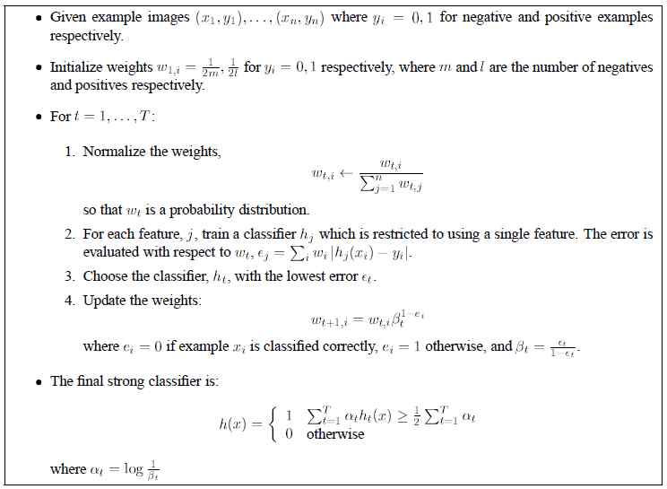
Lets see how AdaBoost gets employed

Slide 3
Lets see how AdaBoost gets employed
So , This code receives the training databases, and receives a Capital T number, often 300-ish
Then, for a Test box (often 50x50) does 300 experts

Slide 4
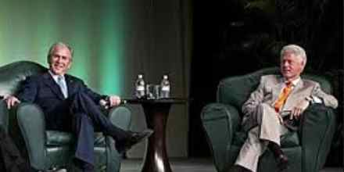
Practical AdaBoost
Consider a Test scene like this one

Slide 5
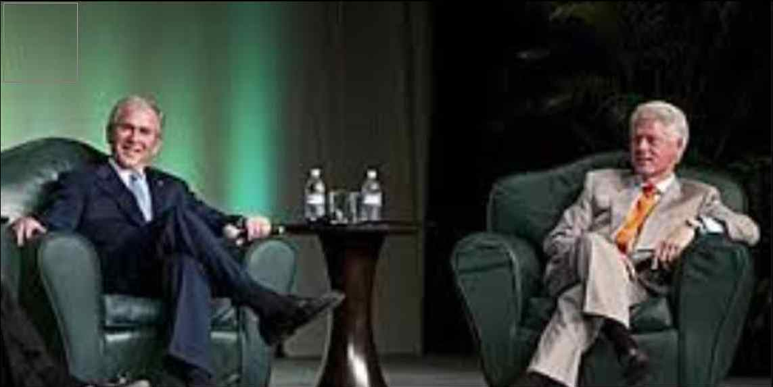
Practical AdaBoost
Consider a Test scene like this one

Slide 6

Practical AdaBoost
Consider a Test scene like this one

Slide 7
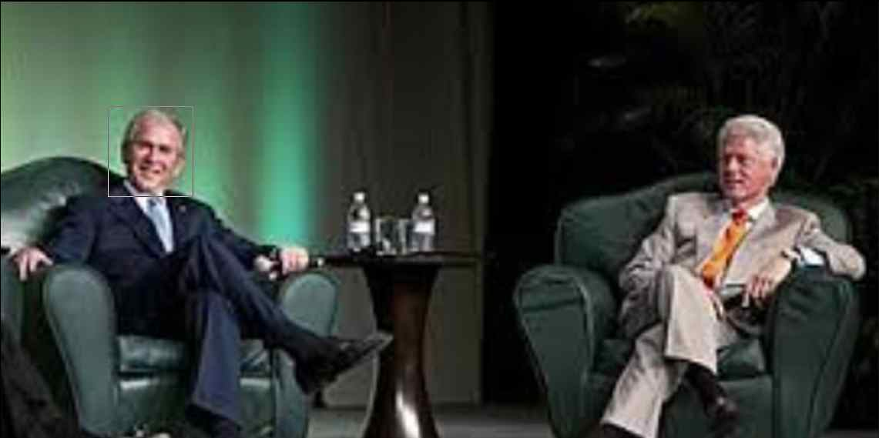
Practical AdaBoost
Consider a Test scene like this one

Slide 8
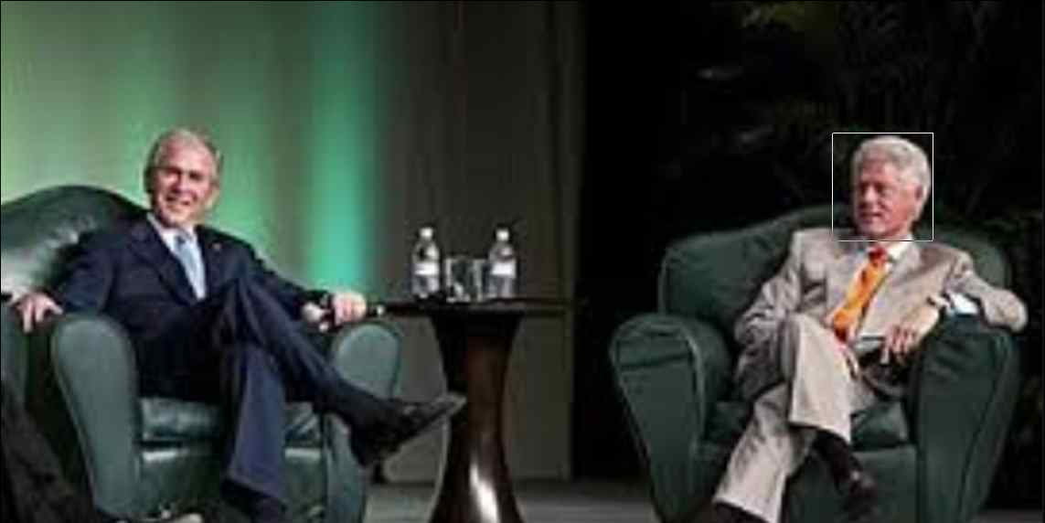
Practical AdaBoost
Consider a Test scene like this one

Slide 9

Practical AdaBoost
Consider a Test scene like this one

Slide 10
Lets see how AdaBoost gets employed
So, employing the AdaBoost approach we know now, would employ about 300 experts at each placement of the 50x50 window.
Our image (in this case) is roughly 250x600,
allowing for roughly 550 placements (at centers) horizontally, and about 200 placements vertically. (Totally, about 200x550 placements, i.e., about 100,000 placements.)

Slide 11
Lets see how AdaBoost gets employed
Out of these 100, 000 placements, the final algorithm will be saying Yes around the areas of the two faces, each face may have about 100 placements near it that might trigger a Yes; so, perhaps, system says Yes about 200 times.
… out of 100,000!! Less than 1 % of the times.
i.e., the majority of the times the system will be saying No. So, do all of these “No” boxes really need all the work of 300 experts to say “No”?

Slide 12
Lets see how AdaBoost gets employed
This leads to a new approach, one that uses the fact that in Face Detection, one is saying “No” most of the time.
So, They design a cascade, a series of stages (each with a small team of experts), like a series of Political Primaries, to eliminate obvious “losers” early, at much less expense than having everyone (all citizens) vote on each contender (which would be expensive).

Slide 13
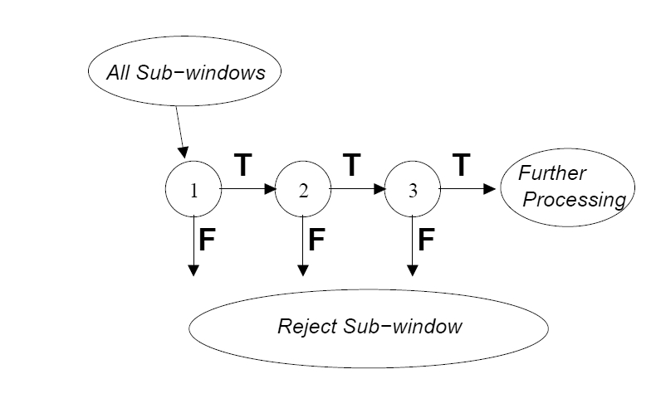
So, Exploit the fact that faces are rare
After making it thru’ all, a window is named “face”
Rejections here are Permanent
The idea here is that with a lower cost at each stage, the system can eliminate (from further consideration) easy rejects. (“T” here means Pass, “F” means False or Fail).
Thus, many of the 1000’s of windows should be rejected with far less expert-time than 300. This is a system made up of a series of teams. A pic is termed “face” if it passes all.
At each “stage” of the cascade, a team (of about 15 to 25 experts) does the following: ensure that the team passes around 99.9 percent of faces entering the test, and failing only around 70.0 percent of non-faces (remember its job would have been to fail 99 percent of non’s). This reduced ability for correctness is due to the reduced team-size.

Slide 14
Team error rate drops as team enlarges
On the previous slide, we observed that the reduced ability for correctness is due to the reduced team-size.
We need to understand that a team of size 1, it will have an error that is the same as the error of its lonely member, i.e., about 35 percent . As the team grows, the team’s error is pushed lower, until finally, with, say, 300 members, its error is about 0.01 (i.e., 1 percent). The error decreases monotonically (not “strictly monotonically”) with the addition of a new member.

Slide 15
So, Exploit the fact that faces are rare
Thus, due to the reduced team-size, the team’s error will be higher, say, 20 percent.
This error will be distributed almost evenly, i.e. there will be about 20 percent False Positive rate, and about 20 percent Missed Detection rate.
But, for a team to have 20 percent Missed Detections will be unacceptable to this new design; so there has to be a way to shift the error in favor of fewer Missed Detections,
while simultaneously raising False Positives to around 40 percent.
.

Slide 16
So, Exploit the fact that faces are rare
Thankfully, this shift can be achieved by making ‘Yes’s be more easy. Just lower the value ½ that is in the final step of the AdaBoost algorithm. This lowering will cause more windows to go through as accepted faces, even if they are not faces. One can lower it in
a loop until all (minus a few) of the faces actually go through successfully. This lowering might be quite significant (i.e., quite a lot lower than ½ ), and because it is substantial, it will drastically increase the False Positive group.
In order to maintain a tight (very small) Missed Detection rate, the False Positive rate must go up; to keep it in check (not to let it exceed, for example, 30 percent), needs the team to grow, so the team DOES grow, but only until those two restrictions are met.

Slide 17
So, Exploit the fact that faces are rare
So, we understand how to make the team grow till 1) a Missed Detection rate of some tight amount is achieved, AND 2) the False Positive rate is brought down below, say, 30.
Next, we need to understand that the 30 percent of non-faces who get out (mistakenly) as faces, will be apprehended (and failed) by a later team.

Slide 18
So, Exploit the fact that faces are rare
So, let us understand how the 30 percent of non-faces who get out (mistakenly) as faces, will be apprehended (and failed) by a later team.
Suppose 1000 faces and 1000 non-faces constitute the databases that are sent into Team 1. After Team 1 is trained, it will pass 99.9 percent of faces (so, 999 faces), and 30 percent of non-faces (300 non-faces), while 700 non-faces along with 1 face will have failed. When Team 2 has finished training, it will also have had a 99.9 percent Detection and 30 percent False Positive rate requirement; thus, now, 998 faces and 90 non-faces will pass as faces. (The 90 non-face number is obtained as 30 percent of 300). That is, 210 non-faces and 1 face will fail at Team 2.

Slide 19
So, Exploit the fact that faces are rare
The 90 non-faces who pass Team 2, will proceed to Team 3, who will fail 70 percent of them (63 will fail), and 27 (30 percent) of them will pass Team 3, to go on to Team 4.
In the meantime, 1 face will fail at Team 3 and 997 will pass on to go to Team 4.
Eventually, (after several Teams), only 9 or less non-faces will be passed (these will be the final False Positives, which is a 10 out of thousand rate, i.e. 1 percent).
Also, you should have observed that if each team has between 15 to 30 experts, then by the end of Team 2, 910 out of 1000 non-faces have failed. So, 91 percent of “failure” cases are booted out with under 50 experts, instead of 300 (the single AdaBoost box).

Slide 20
So, Exploit the fact that faces are rare
We have presented how the system of teams will work when the teams are built and are “in place”. Hence, the training task is to get the teams assembled.
We have been loose in talking about windows being sent in to the teams. The input will be a window when the system is in the real world mode (sometimes called the Testing mode, to distinguish it from the Training mode); it will be one window at a time, by a scanning procedure, that will cut a window (from the large picture) and send it in to the system. Immediately after the Training is complete, one can ask how the system performs on the training databases. In this case, the input to the system of teams is the collection of database pictures (each is the same size as a window), and that is the process that we have been talking about in the last few slides.

Slide 21
So, Exploit the fact that faces are rare
Let us make one observation about the nature of the mix of pictures (or windows) that show up at the doorstep of a team. At Team 1, the complete database (or in Test mode, the complete world) shows up. In Test mode, at Team 2, only those windows that passed Team 1 will show up. Thus, the training should reflect this constraint: the constraint that the mix of who shows up at the doorstep for Team 2 is different. Thus, for Team 2, the training examples will be only those who pass Team 1, after Team 1 is fully trained up.

Slide 22
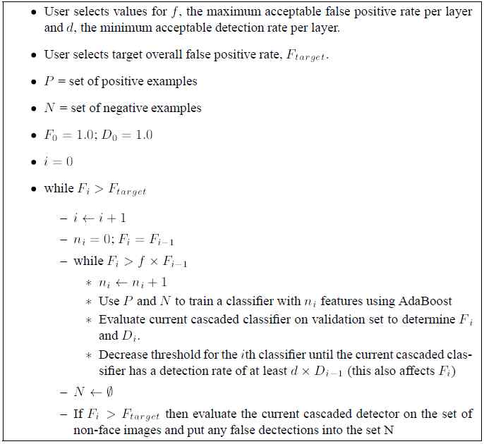
The Cascade Algorithm
Here is the
Complete
Cascade
Algorithm;
In next two
slides, we
will explain
in detail.

Slide 23
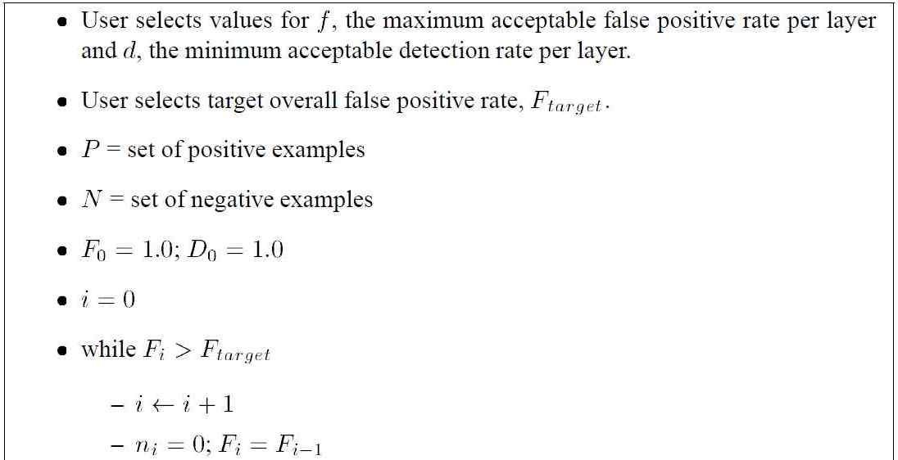
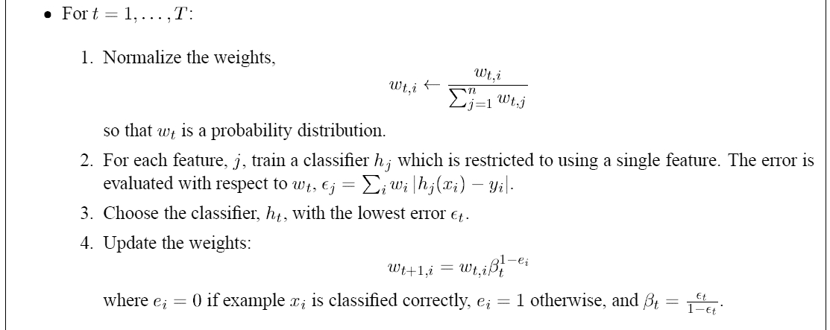
The Cascade Algorithm: Initializations

Slide 24
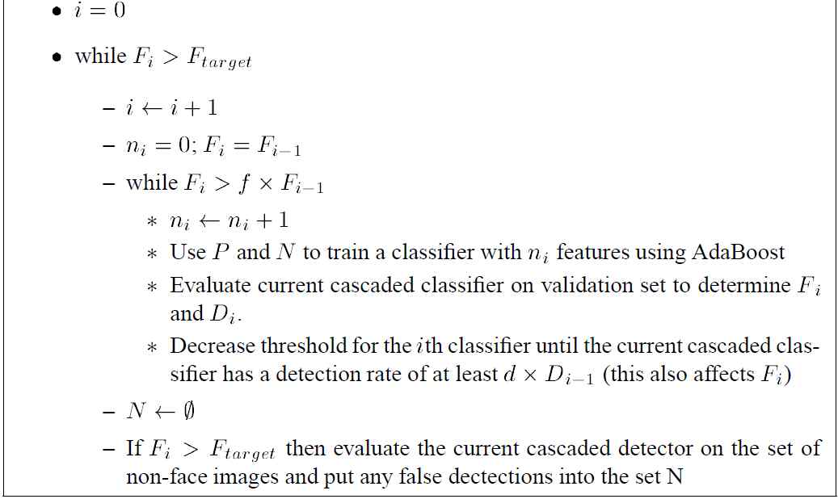
The Cascade Algorithm: the loops

Slide 25
Summary Thoughts on Cascades
Note that this cascade works to speed things up only because the observation is true that positive tests are rare.
The cascade is not about getting more correct results than the Single Team approach. Correctness is tied to the team size. Hence, a single team can achieve any needed correctness target, given enough members.
The Cascade gets the same correctness as the Single Team, but gets the results much faster.

Slide 26
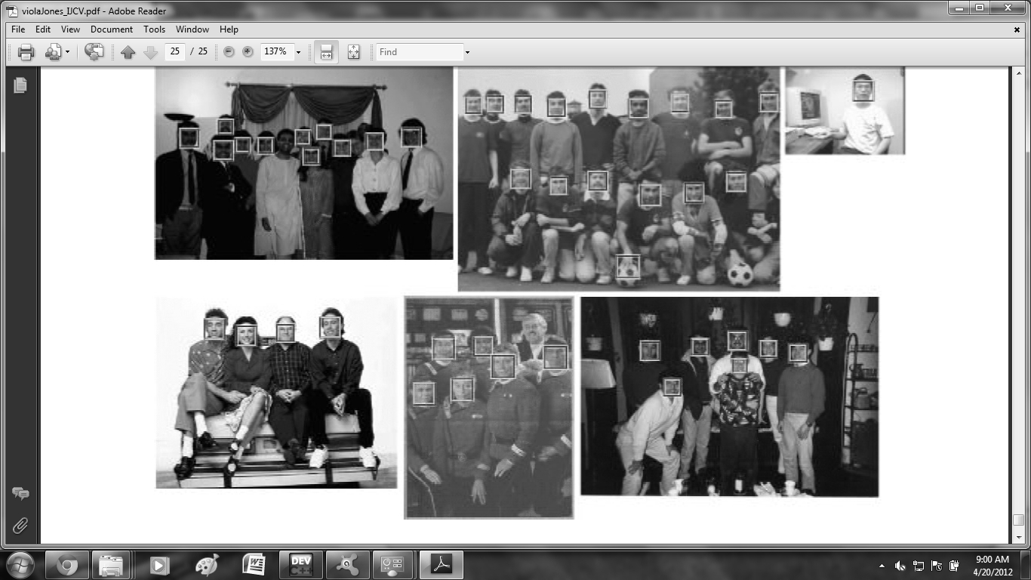
Examples of Faces Found

